Slide 1
Q1 Project: Chlorophyll-a Predictive Model
Nikhil Alladi, Petr Kisselev, Jacob Dipasupil

Slide 2
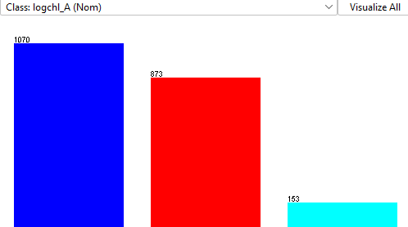
Data Information
2226 instances (lakes), 67 attributes
Class: logchl_A
Heavily right-skewed

Slide 3
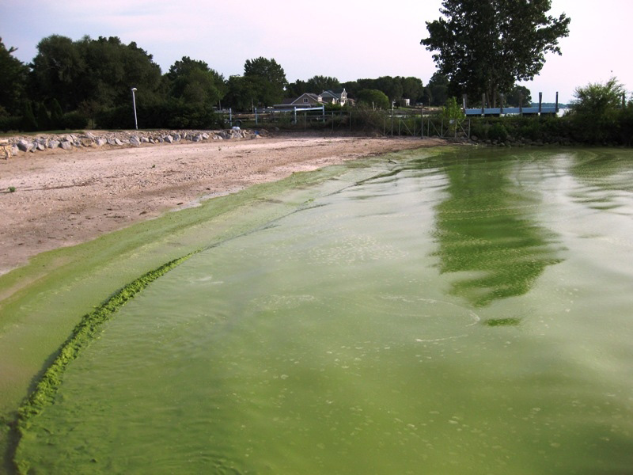
Motivations
Chlorophyll-a indicates lake health
High chlorophyll-A concentration leads to algae blooms
Algae blooms cause:
Hypoxia
Toxin production
Early prediction saves health
A harmful algae bloom on Lake Erie.

Slide 4

Preprocessing (I)
Excel Cleaning (#DIV/0, #NUM, #VALUE)
Empty class instance removal
First-pass logic trimming
LAKENAME
Survey Number
SITE_ID

Slide 5
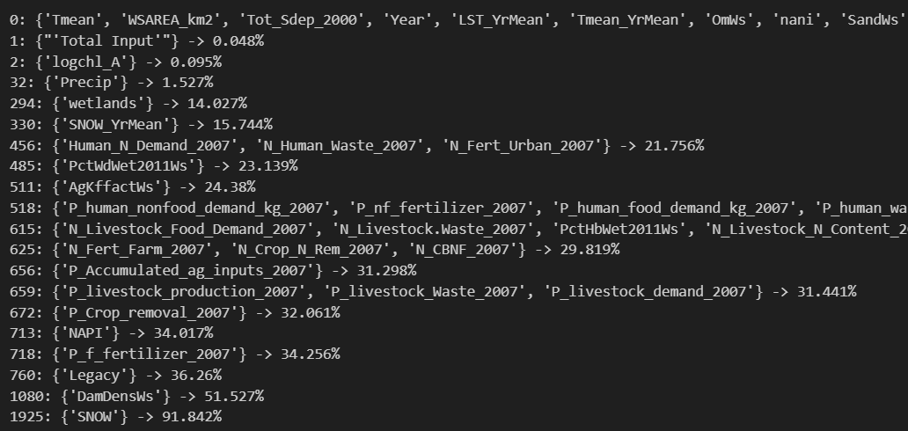
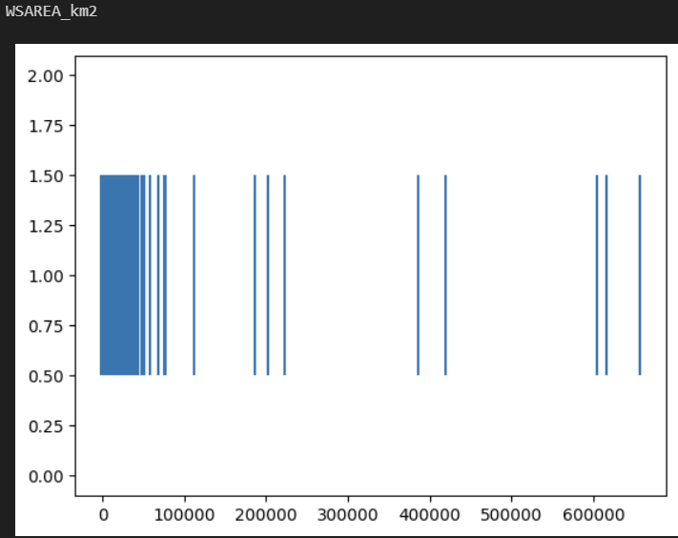
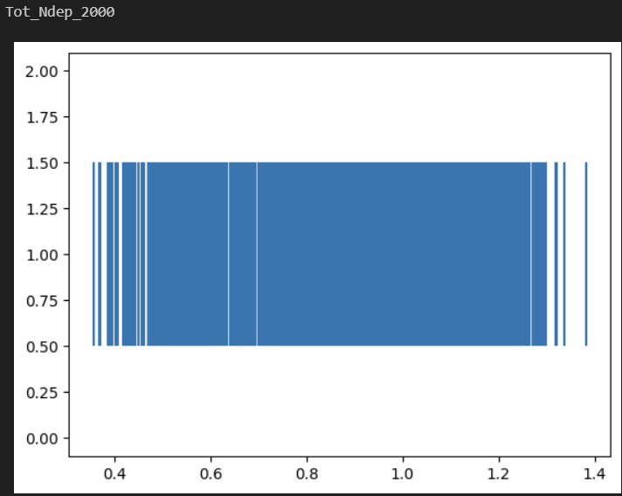
Preprocessing (II)
Missing values per attribute
SNOW
Normalization
Z-Score vs min-max
To be z-score normalized
To be min-max normalized

Slide 6
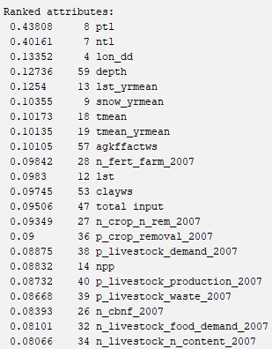
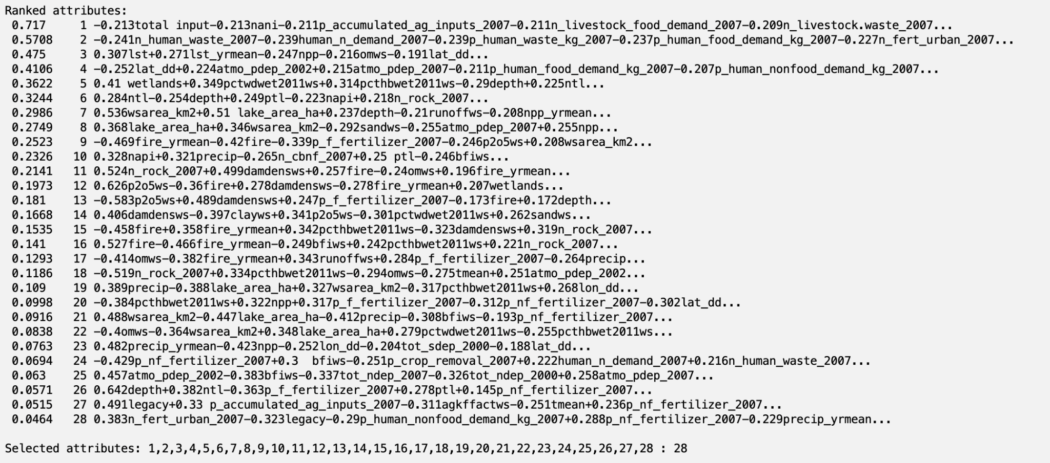
Attribute Selection (I)
Learner-Based Information Gain
Principal Component Analysis
Threshold: 0.2
Threshold: 0.1

Slide 7
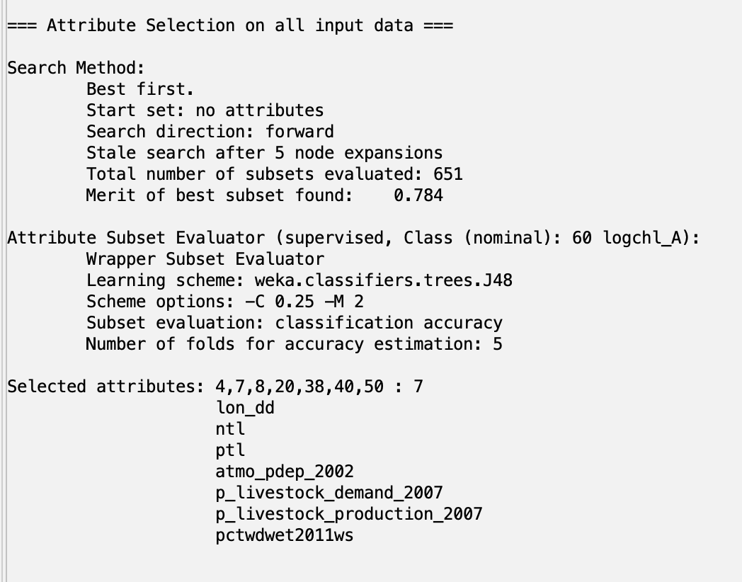
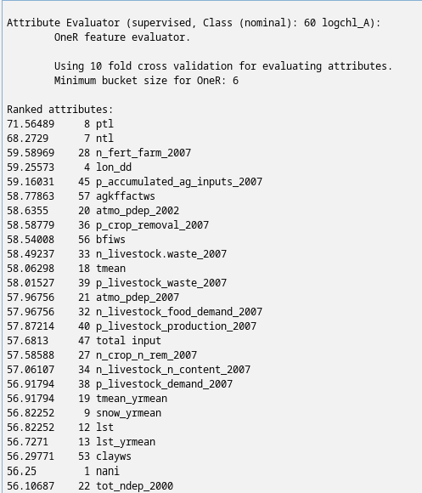
Attribute Selection (II)
Learner-Based with J48
OneR Attribute Selection
Threshold: 58.5

Slide 8
Attribute Selection (III)
Self-Picked Attributes:
- lat_dd
- lon_dd
- ntl
- ptl
- atmo_pdep_2002
- n_human_waste_2007
- n_livestock.waste_2007
- p_livestock_waste_200a7
- p_human_waste_kg_2007
- runoffws
Common appearance in attribute selection
lon_dd vs lat_dd (added both to be complete)
Focused on attributes related to Nitrogen and Phosphorus

Slide 9
Classifier Models
What we selected:
Naive Bayes
Predicts probabilities of a given instance through recursively combining probabilities for parts of it
Surprisingly effective with small amounts of data
Logistic Regression
Similar to a linear regression but with the logistic function instead
Parameters are µ (center) and s (scale)
Learner Based / J48
Java-based open source version of the popular C4.5 algorithm
Creates decision tree by splitting data in the way to maximize information gain
RandomTree
Constructs a decision tree with k branches at each node
“Random” because at each node the attributes that will be used are randomly selected

Slide 10
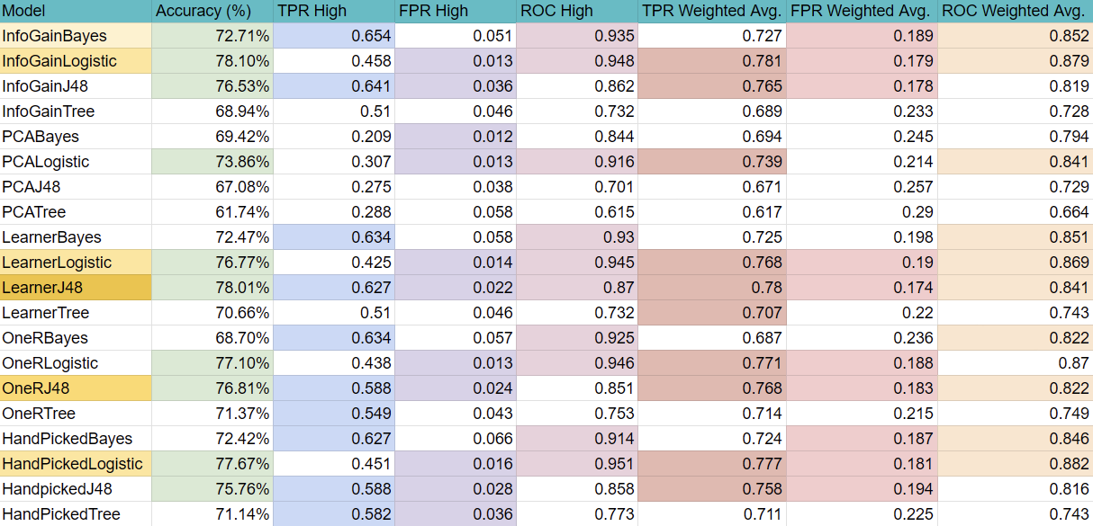
Results

Slide 11
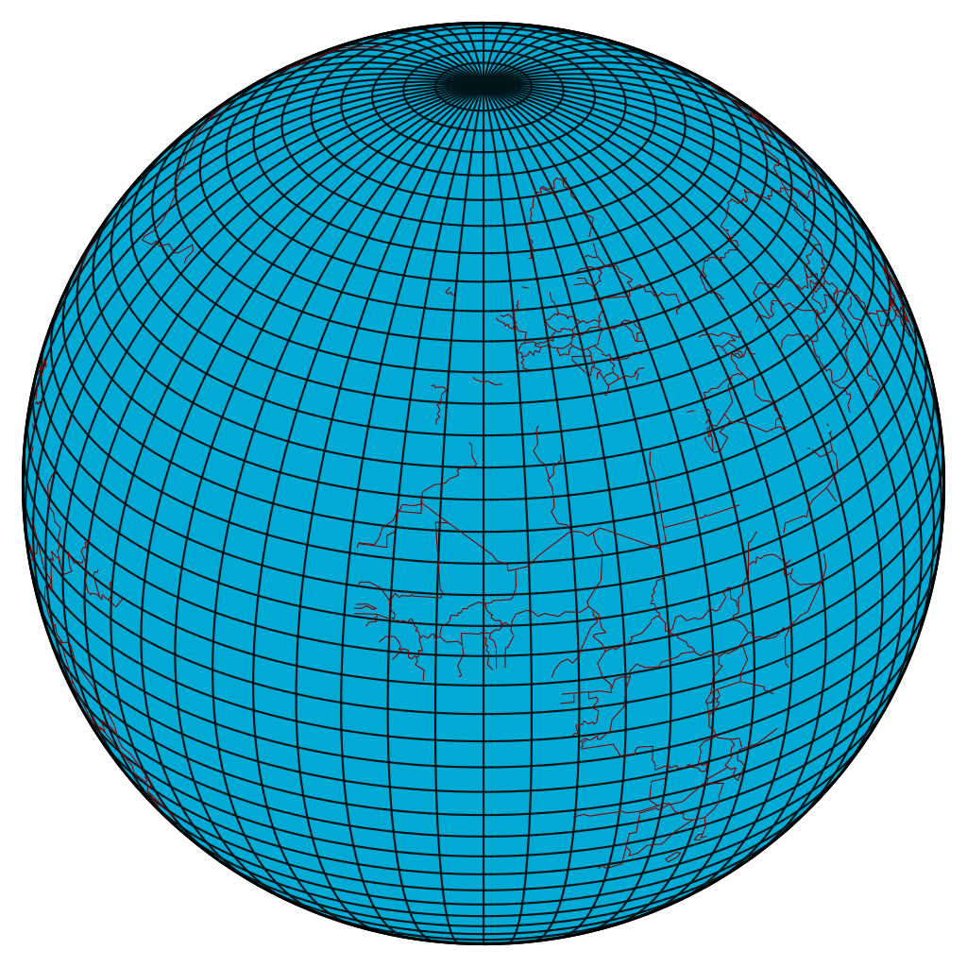
Conclusion, Limitations, Future Work
Decently accurate model (78% at best model/attribute pick)
Use more recent data
Even class distribution
Combination of different attributes
Many attributes contribute to phosphorus or nitrogen concentrations

Slide 12
Citations
Algae image: https://en.wikipedia.org/wiki/Harmful_algal_bloom#/media/File:Blue-gree_algae_bloom_Lake_Erie.png
Latitude image: By Hellerick - Own work, CC BY-SA 3.0, https://commons.wikimedia.org/w/index.php?curid=26737079

